Slide 1
Number System and Codes

Slide 2
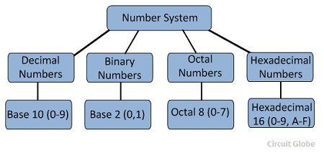
Number system

Slide 3
Signed Binary Numbers
In signed binary numbers the leftmost bit represents the sign and rest of the bits represents the number.
Sign bit = 0 for positive
= 1 for negative

Slide 4
Signed magnitude system
The leftmost bit is to represent the sign and rest of the bits represents the magnitude of the number.
Sign bit | Magnitude of the number

Slide 5
Signed Complement Representation
Used for representing negative numbers.
The leftmost bit is to represent the sign and rest of the bits represents the complement of magnitude of the number.
The signed complement system can use either 1’s or 2’s complement.
Sign bit | Complement of Magnitude of the number

Slide 6
Decimal | Signed magnitude | Signed-1’s complement | Signed-2’s complement
+7 | 0111 | 0111 | 0111
+6 | 0110 | 0110 | 0110
+5 | 0101 | 0101 | 0101
+4 | 0100 | 0100 | 0100
+3 | 0011 | 0011 | 0011
+2 | 0010 | 0010 | 0010
+1 | 0001 | 0001 | 0001
+0 | 0000 | 0000 | 0000
-0 | 1000 | 1111 | --------
-1 | 1001 | 1110 | 1111
-2 | 1010 | 1101 | 1110
-3 | 1011 | 1100 | 1101
-4 | 1100 | 1011 | 1100
-5 | 1101 | 1010 | 1011
-6 | 1110 | 1001 | 1010
-7 | 1111 | 1000 | 1001
-8 | -------- | ---------- | 1000

Slide 7
Binary Codes
“An n-bit binary code is a group of n bits that assume up to 2^{n} distinct combinations of 1s and 0s, with each combination representing one element of the set being coded”.

Slide 8
Classification of binary codes
Weighted Codes :
Binary codes which obey the positional weight principle.
Each position of the number represents a specific weight.
Ex: BCD 8421
Non-Weighted Codes:
Binary codesin which the positional weights are not assigned.
Ex: XS-3, Gray Code

Slide 9
Classification of binary codes. cont
Sequential code:
The code in which each succeeding code word is one binary number greater than its preceding code word.
Mathematical manipulation of data.
Examples: 8421 BCD, XS-3

Slide 10
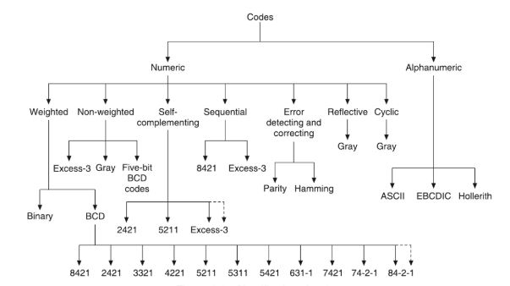
Classification of Binary codes

